Slide 1
Dora Stratou
International Consulting Program
July 1, 2016

Slide 2
Presentation Outline
Introduction to the Project
Findings & Analysis
-Target Market Analysis
-Social Media
- Media Partners
Conclusions
Recommendations

Slide 3
What is This Project All About
The US participation is low in the CID - World Congress, Greece
2. Increase those numbers

Slide 4
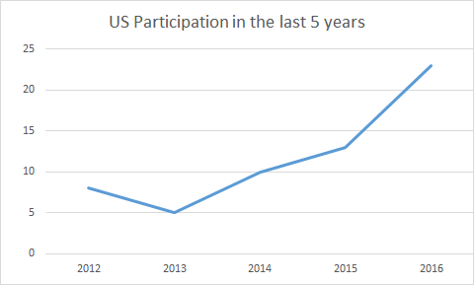

Slide 5
Objective
We will aim to provide Dora Stratou and CID information by answering the following:
Is the current form of communication strategy effective enough?
What can be done to enhance the communication strategy?
Where are the hotbeds in the U.S for dance professionals?

Slide 6
Findings & Analysis
Target Market: dance professionals including dance scholars, educators, & researchers
Dance Organizations & Dance Hotbeds in US
Social Media as a Communication Tool
Media Partners and Collaborators
Notes:
Denajia
I already have what im saying. Im mentioning social media whwen i talk about brandon’s part

Slide 7



NDEO
Universities
National Dance Education Organization
Provides dance educators and administrators a network of resources and reports
Promotes knowledge and appreciation and supports processes of dance education
Notes:
Denajia

Slide 8
Top 5 Cities & Metro Divisions
Washington-Arlington-Alexandria, DC-VA-MD
Nashville-Davidson-Murfreesboro-Franklin, TN
New York-Jersey City-White Plains, NY-NJ
Boston, MA
San Francisco-Redwood City-South San Francisco, California
(National Center for Arts Research)
Notes:
Denajia

Slide 9
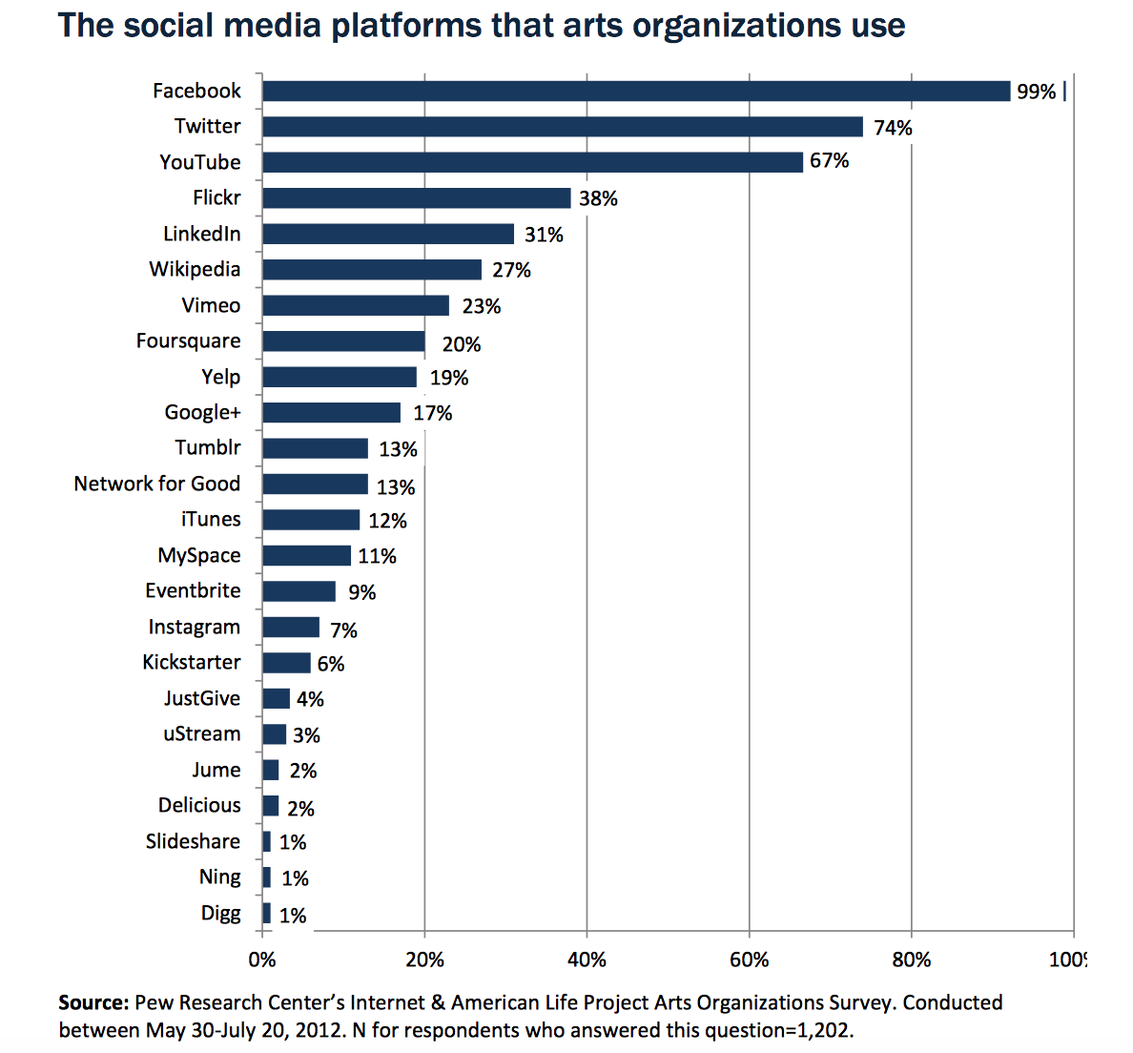
Social Media(1)
56% of art organizations in the U.S. maintain 4 to 9 social media sites.
Main uses of social media in the dance industry:
  Networking
  Event promotion
  Engage members

Slide 10
Social Media (2)
How to effectively maintain a strong social media presence:
Have a designated staff to focus on social media content
Post frequently, at least multiple times per week
Post videos and photos as a visual representation of past and upcoming conferences
Post relevant information that can benefit members.
Use sites as forum for discussion to keep members engaged

Slide 11
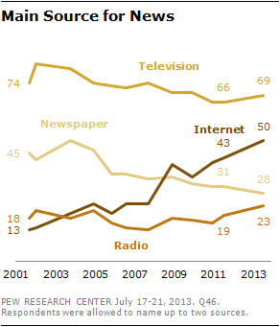
Media Partners (1)
Overall dramatic increase of 37% of people relying on internet for their daily dose of news
Television and printed newspapers demonstrated a decrease of 15% and 17% respectively.

Slide 12
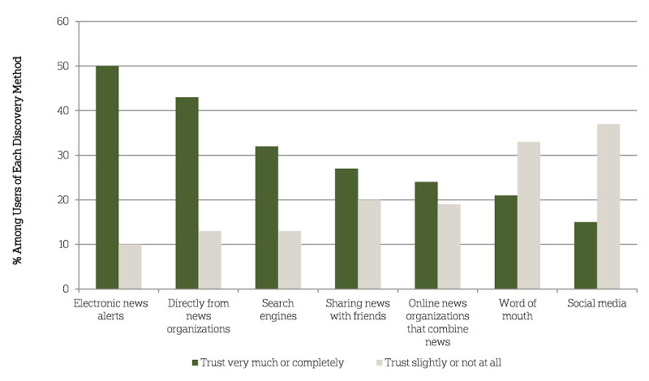
Media Partners (2)
American Press Institution highlights that news transmitted via an electronic format (magazines, journals websites, etc) are the considered the most reliable ones.
In the contrary social media and word of mouth fail to convince their audience,are treated with suspicion and usually need to be backed up by another source that has a higher level of credibility.

Slide 13
Media Partners (3)
Magazines
Dance Magazine
Dance Teacher Magazine
Dance for you Magazine
Dance Informa Magazine
Dance Research Journal - published by the CORD-
Blogs
Dance Advantage
Art Intercepts
The Dance Journal
Television
Dance Channel
Mezzo

Slide 14
Media Partners (4)
The research and material published in the International Conference hosted by Dora Stratou should be made easily accessible to future researchers,
There are several websites and services that connect journalists and writers with sources. Help A Reporter (HARO) is one of the most well known and popular resources, mostly used in the US and does not require any fees.
Other services are ProfNet from PR Newswire, Experts.com, and Muck Rack

Slide 15
Conclusions
Dora Stratou has a relatively poor digital presence in terms of social media and media partners. In order to gain fame the company mainly relies on the word of mouth.
The company must develop new approach methods starting from the presented dance hotbeds and prestigious universities
Moreover, other art organizations use extensively social media to promote their work and engage with their audience with Facebook being the leading medium
.By reaching out to the appropriate online publications and TV channels the company could expand and attract more of the desirable audience
The published material should be available for future researchers

Slide 16
Recommendations
Use of Social Media
Approach specialized media partners
Register to Help a Reporter Out (HARO) platform
Contact the best dance schools and organizations in US
Request feedback from participants

