Slide 1
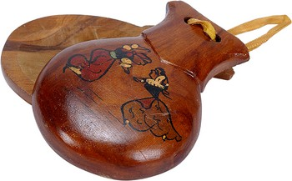
“The dance studio with the sound of castanets”

Slide 2
LECTURE - DEMONSTRATIONS
BY :
RITA GALDIERI
AND
FATIMA RANIERI
ITALY

Slide 3
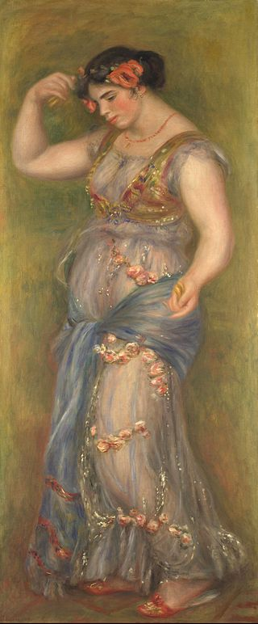
Painting by
Pierre-Auguste Renoir
Girl intent on dancing to the
rhythm of castanets

Slide 4
EXPLANATION OF THE LESSON
THE DANCE CLASS IS MADE UP OF A SEQUENCE OF SEVERAL EXERCISES:
-BASIC EXERCISES TO THE PREPARATORY STUDENTS (5/9 YEARS OLD)
-BAR ,CENTER,POINT TO THE ACADEMIC COURSES (10/18 YEARS OLD)

Slide 5
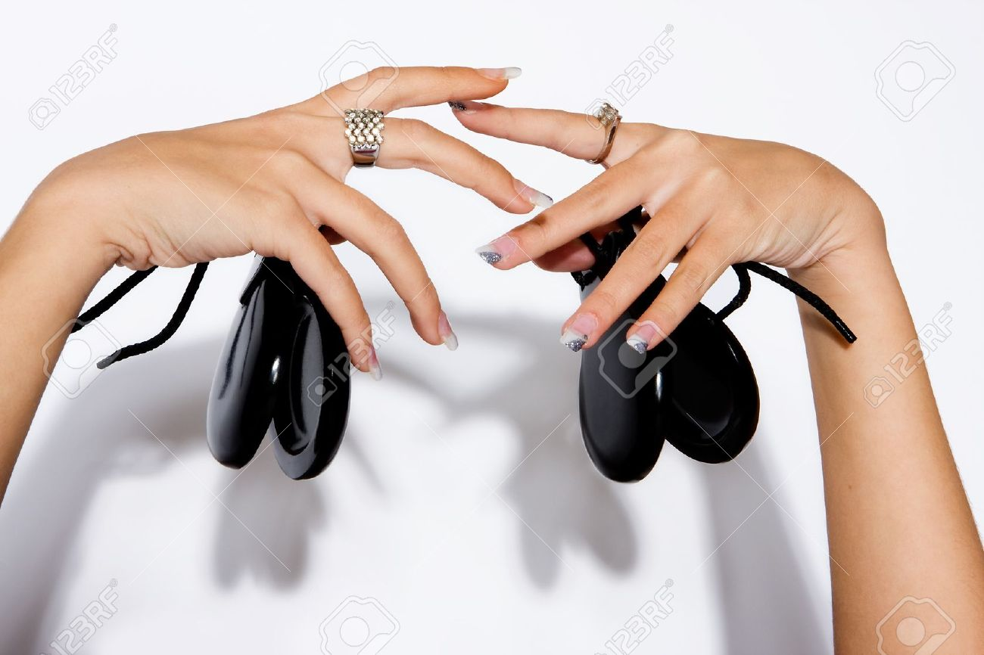
WITH THE PARTICULARITY OF NOT BEING ACCOMPANIED ONLY BY THE PIANO BUT ALSO FROM PERCUSSION INSTRUMENT “CASTANETS”

Slide 6
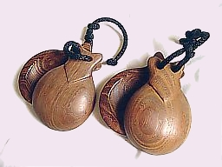
AIMS
BEING THE CASTANETS A
PERCUSSION INSTRUMENT
AND INDETERMINATE PITCH
BUT STRONGLY RHYTHMIC,
NEW TO THE BALLET LESSON,
IT WILL BE EASIER FOR THEM
TO FOLLOW THE TIMED
EXERCISES AND THEREFORE
MORE EXERCISE MUSICALITY

Slide 7
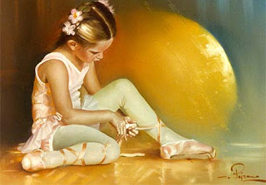

Slide 8
VARIOUS EXAMPLES OF EXERCISES
OF LESSONS
CAPE EXERCISE : on the rhythm of the music from the ballet “CARMEN” Bizet
EXERCISE OF ARMS: on the rhythm of the music from the ballet “COPPELIA” Léo Delibes

Slide 9
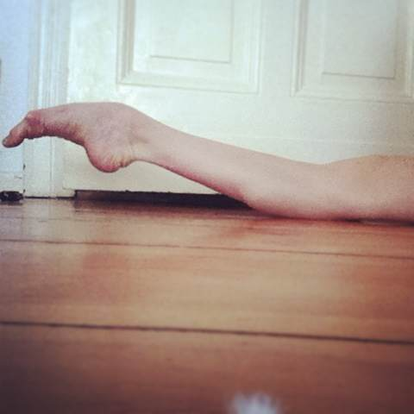
FOOT EXERCISES: on the rhythm of the music from the ballet “SYLVIA” Léo Delibes
LEGS EXERCISE: on the rhythm of the music from the ballet “ROMEO AND JULIET” Prokofiev

Slide 10
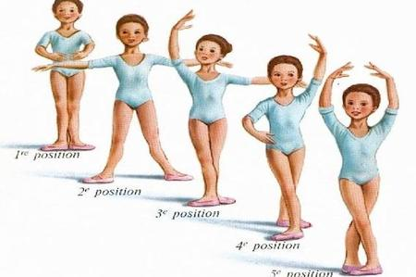

Slide 11
OPENING EXERCISE: dance of the angels from the ballet “NUTCRACKER” Tchaikivsky
SMALL CHOREOGRAFHIC COMPOSITION: on the rhythm of the music from the ballet “SYLVIA” Léo Delibes

Slide 12
BAR EXERCISE: chinese dance from the ballet “NUTCRACKER” Tchaikovsky
CENTER EXERCISE ADAGIO: from the ballet “SLEEPING BEAUTY” Tchaikovsky

Slide 13
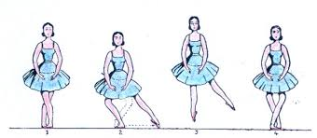
JUMPS EXERCISES: Russian dance from the ballet “NUTCRACKER” Tchaikovsky

Slide 14
BY:
RITA GALDIERI and FATIMA RANIERI
ROME- REGGIO CALABRIA ( ITALY )

Slide 15
THANKS!!!

