Slide 1
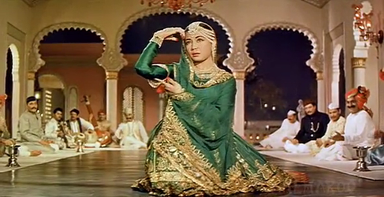
Indian Dance Jewellery
Simran Godhwani,
Anandaa Foundation

Slide 2
History
Temples as centres of music and dance…offerings to Gods and Goddesses…popularising mythologies, dancers playing Gods
Royal courts of Kings patronising arts…opulence and craftsmanship in the jewellery
Influence of other cultures, conquerors: example Persian
Adoption of newer materials in costumes and jewellery, societal approach to dresses…post colonial sanitisation
Current contemporary society and preservation of cultural heritage

Slide 3
“Natya Shastra”
Ancient Indian text describing the Art and Science of dance.
Covers all aspects of dance: space, codes, music etc
Special place for Jewellery
The first and most important aspect mentioned is Shringar – adornments (ornamentation, embellishment, beautification)

Slide 4
Evolution of styles
Different dance forms in different parts of India
Local material (Silver for Odissi, Gold for Bharatnatyam etc), local styles aligned to local culture and context (India is like Europe…different distinct cultures together)
Migration/evolution of Folk to classical of some dances (Odissi for example), changing sophistication of the Jewellery along with that
Jewellery and Costumes as part of codified vocabulary of classical forms-implied and explicit meanings ascribed to different pieces of jewellery to denote and convey something specific

Slide 5
Role of jewellery
To accentuate the beauty of the dancer
Adds to the rhythm of music (Ghungroos…bangles)
Denotes status of characters (leading roles Vs others, class differences)
Codification of vocabulary with specific ornaments
Creating moods, emotions and denoting changes in them
Playing a part in the story (Sita dropping her Jewellery when abducted to show the way, giving her ring to Rama)

Slide 6
Body and the Jewellery

Slide 7
A listing of typical Jewellery

Slide 8
Examples of Jewellery
Head To Toe

Slide 9
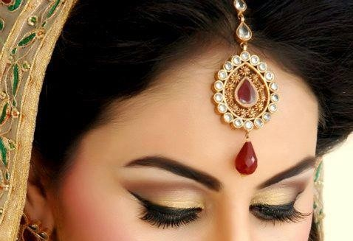
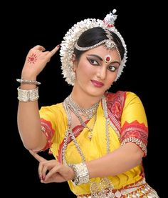
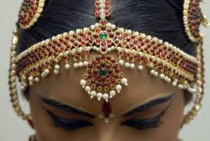
The tika is a composite ornament composed of a chain with a hook at one end and a pendant at the other.
The hook holds the tika at the hair end, while the pendant falls on the exact center of the forehead.
The maang tikka is a prime accessory for Indian Classical dancers. It represents the third eye, or the power of the soul. The forehead’s center, where the maang tikka is placed, also signifies one’s ability to control emotions, and the power of concentration.
In Odissi it is called the Seenthi, Mathami or Matha Patti (forehead ornament), Allaka (head piece on which the tikka hangs),
In Bharatnatyam, the Mang tika is accompanied by the Surya (Sun) and Chandra (ornaments) too.
Mang Teeka

Slide 10
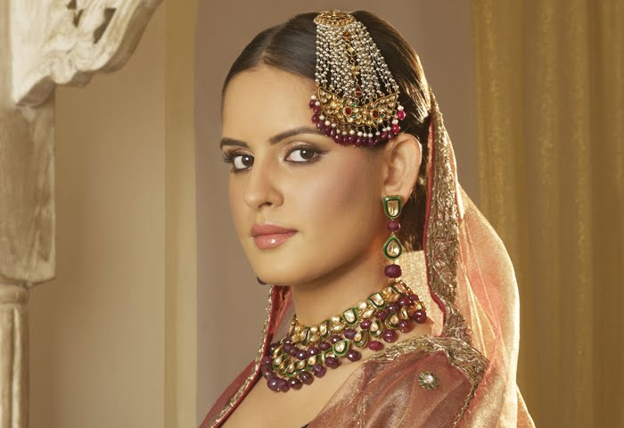
Jhoomar - Passa
Traditional Kathak jewellery worn for side heads with both hooks attached to the hair. It came into existence with the Mughal Empire.
Passa is hindi or urdu word used for one side. It is known by many names like half mang tika, jhumar etc all meaning that the tika worn on one side.
The Kathak dancers usually wear it while they are presenting Mughal influenced compositions
This particular jewellery piece is very symbolic to only the Kathak style of classical dance

Slide 11
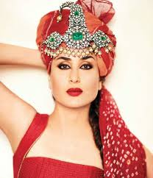
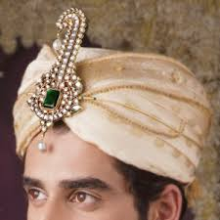
SARPECH- Head Jewellery
This piece of jewellery originated from Rajasthan. It is made of uncut diamonds and elongated emerald drops. It is topped by a paisley crest. Elaborate Jaipur enamel work covers the reverse of the ornament, not seen here.
The origin of this ornament dates back to 2000 years ago. The proof are the paintings on the Ajanta Temples of women with similar head ornaments worn as tiaras.
The Sarpech or Shirpej, is also an ornament worn on princely turbans also meaning an adornment for the head, developed, in medieval India. It reached perfection in the courts of the Moghuls and the princes of Rajasthan.
The craftsmanship used for developing this ornament reached its pinnacle in the 16th century where a king by name Maharaja Man Singh from Jaipur got enamel work experts from Lahore, Pakistan.

Slide 12
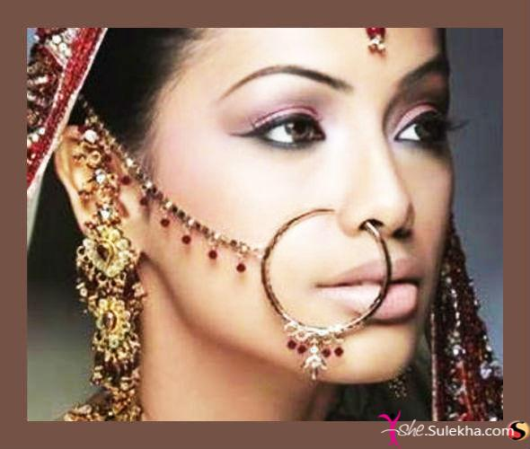
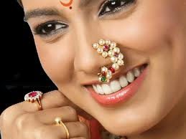
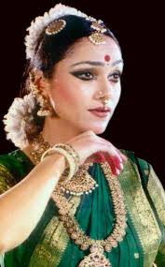
NATH – NOSE ORNAMENT
Nose ornaments have been of different types. There are the single stone and the clove-shaped Laung worn on one side of the nose, the jewel worn through the cartilage in the centre of the nose, the Bulak, and Naths of various shapes and designs.
One of the most elegant, however, is the Nath of Maharashtra.
Rarely does one see any reference to nose jewellery in the ancient Hindu texts from which it appears that it could have been brought into the country by Muslims in the 9th or 10th century A.D.

Slide 13
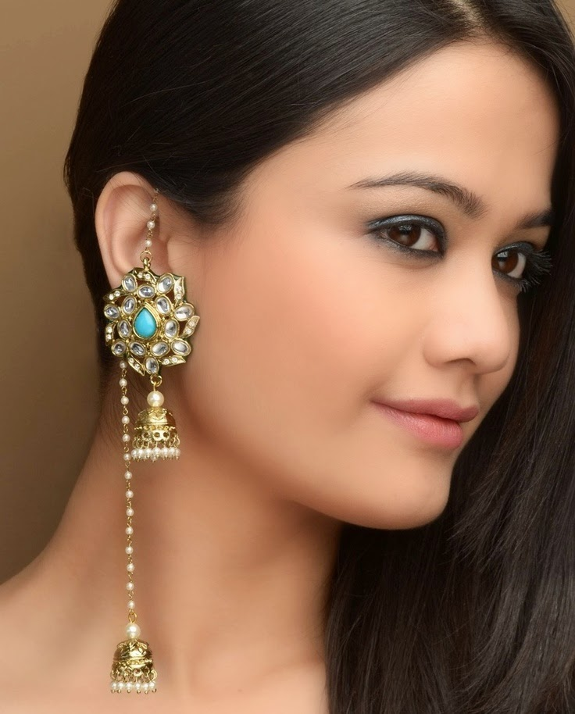
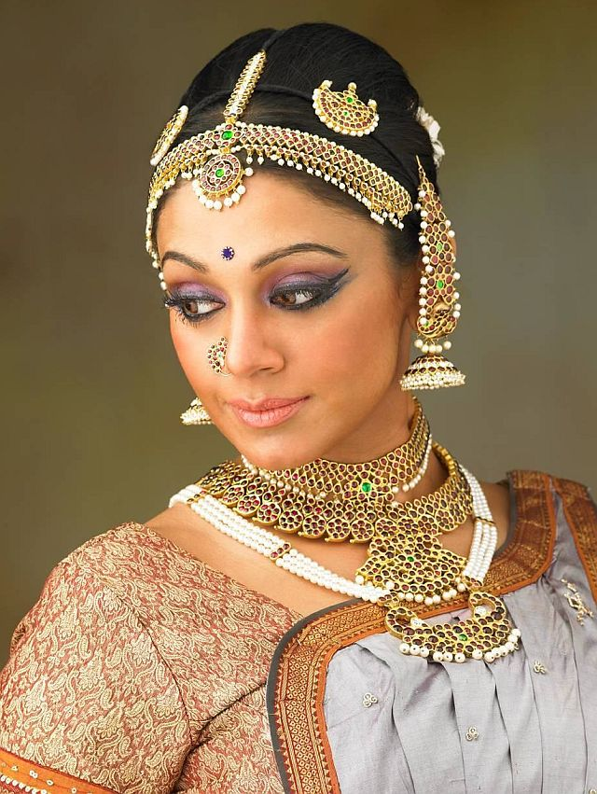
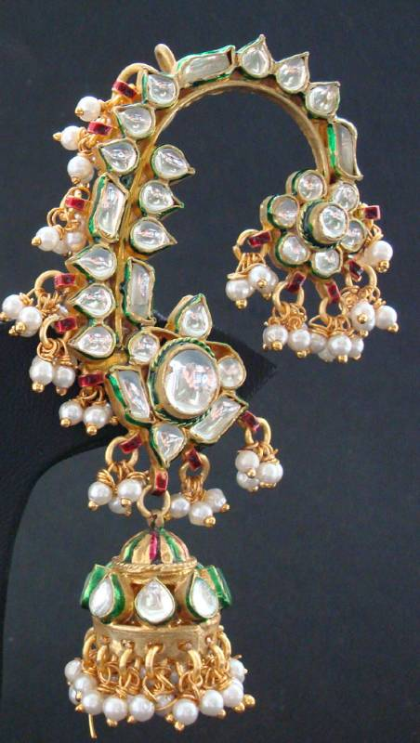
KARANPHOOL JHUMKA – Earring
Karanphool Jhumka is from Rajasthan (Karanphool meaning a flower for the ear). unique ear covers in intricate shapes usually depicting a peacock’s feathers, an ear chain attached or two strands of pearls are taken around the ear to support the weight of the jewel to Jhumkas (bell shaped earrings).
The Bharatnatyam dancers call it Jimkis, Odissi dancers they are ear covers called Kapa attached to Jhumkas
The projection at the rear is also for the purpose of attaching it to the hair to minimise the weight on the ear.
In olden times, to make room for more ornaments, the ear was pierced in four places -- the lobe, the inner ear, the outer part of the middle of the ear and the top of the ear.
The most popular jewel for the ear in the north has been the Karanphool, with the flower motif in the centre of the ornament. The Jhumka in the shape of a bell has also been separately worn.

Slide 14
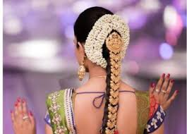
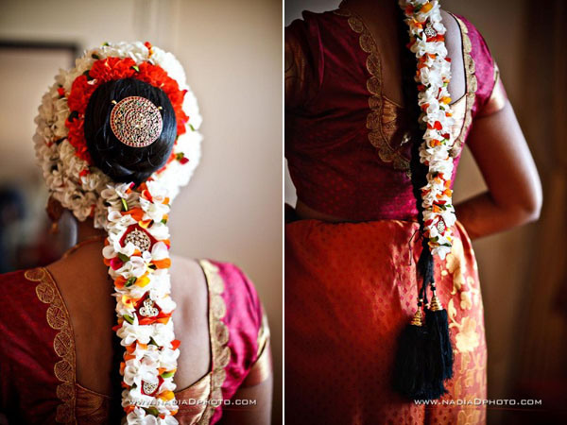
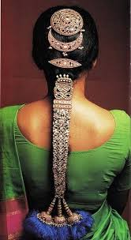
JADANAGAM – HAIR ORNAMENT
The Jadanagam of South India, the hair-serpent, is worn by dancers to decorate braided hair. The rakkadi at the back of the head in the shape of the sun, symbolic of brilliance and power, is followed by the crescent moon, evocative of calm and peace. The third piece is the fragrant thazhambu flower (screwpine).
Then comes the ruby and diamond-studded many-headed divine cobra, Ananta, below whom are seen three rows of the cobra's coils. From here the jewellery for the braided hair starts. Designed in the form of flowers and buds, it consists of separate pieces interlaced to form a supple ornament. Towards the end of the braid it bursts out into 3 silk tassels held together by encrusted bells.
This jewel was also adopted by Devadasis, or temple dancers, who considered themselves the brides of the temple deity. This tradition has continued to this day when we see Bharat Natyam dancers wearing the Jadanagam or, where it is not available, a substitute woven out of flowers.

Slide 15
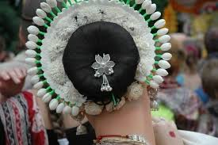
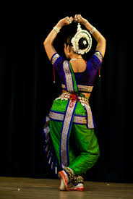
HEAD PIECE – Tahiya, PUSHPACHUDA
The crown
The mahkoot consists of two parts. The flower decorated back piece, called the ‘gobha’, sits around the dancer’s hair pulled into a bun at the back of the head.
This piece represents the lotus with a thousand petals that lies above the head in the head chakra, or energy center
The longer piece that emerges from the center of the back piece is called the Tahiya, and this represents the temple spire of Lord Jagannath or the flute of Lord Krishna.

Slide 16
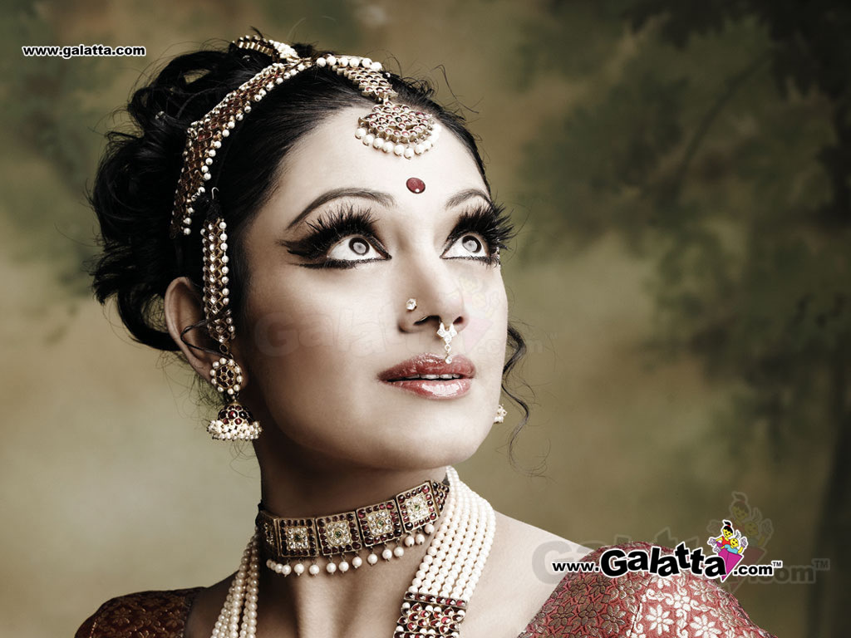
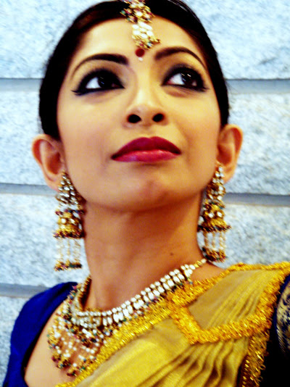
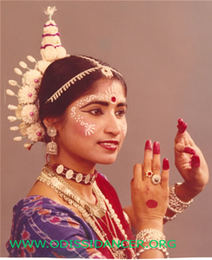
Choker
A choker is a close-fitting necklace worn on the neck. Chokers can be made of a variety of materials
Chokers appeared in 1798 as a French cultural jewel that was worn by wealthy ladies. in 1874 it was worn by ballerinas and in the early 1880s by queens.

Slide 17
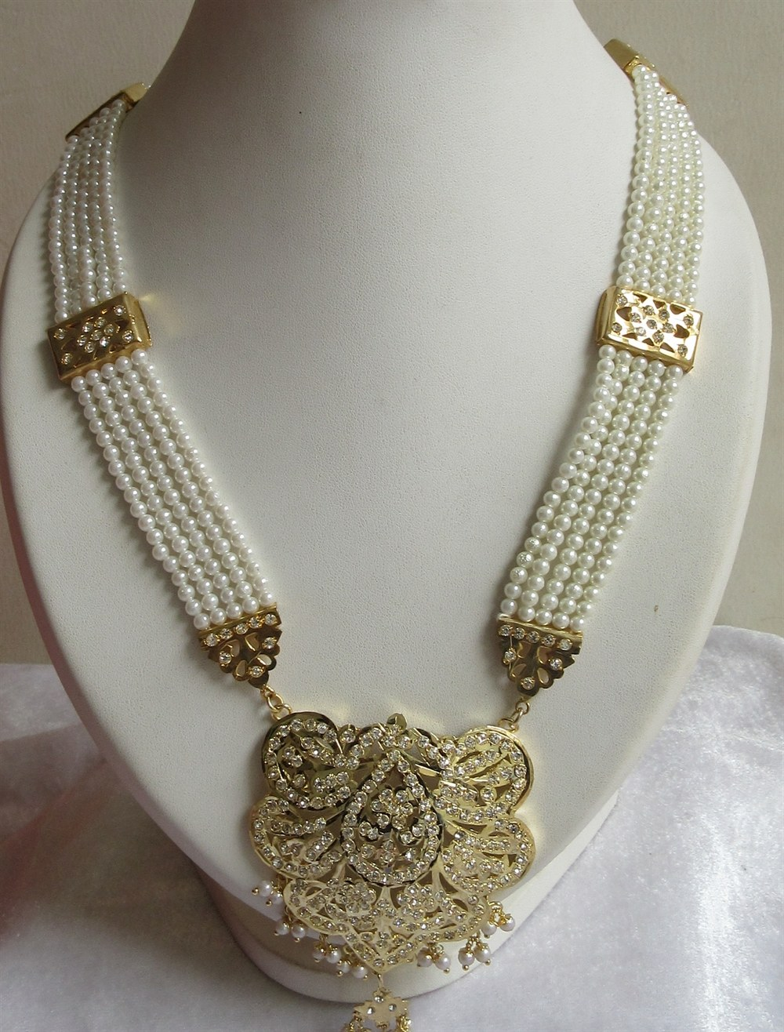
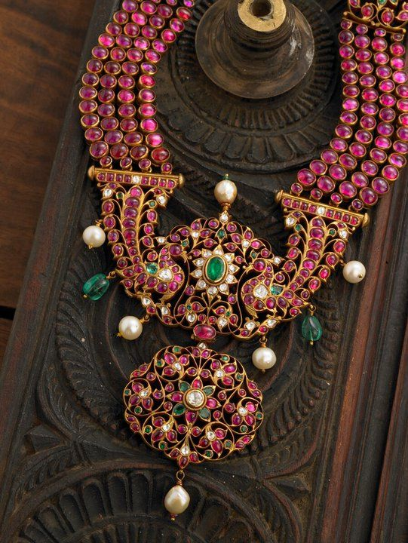
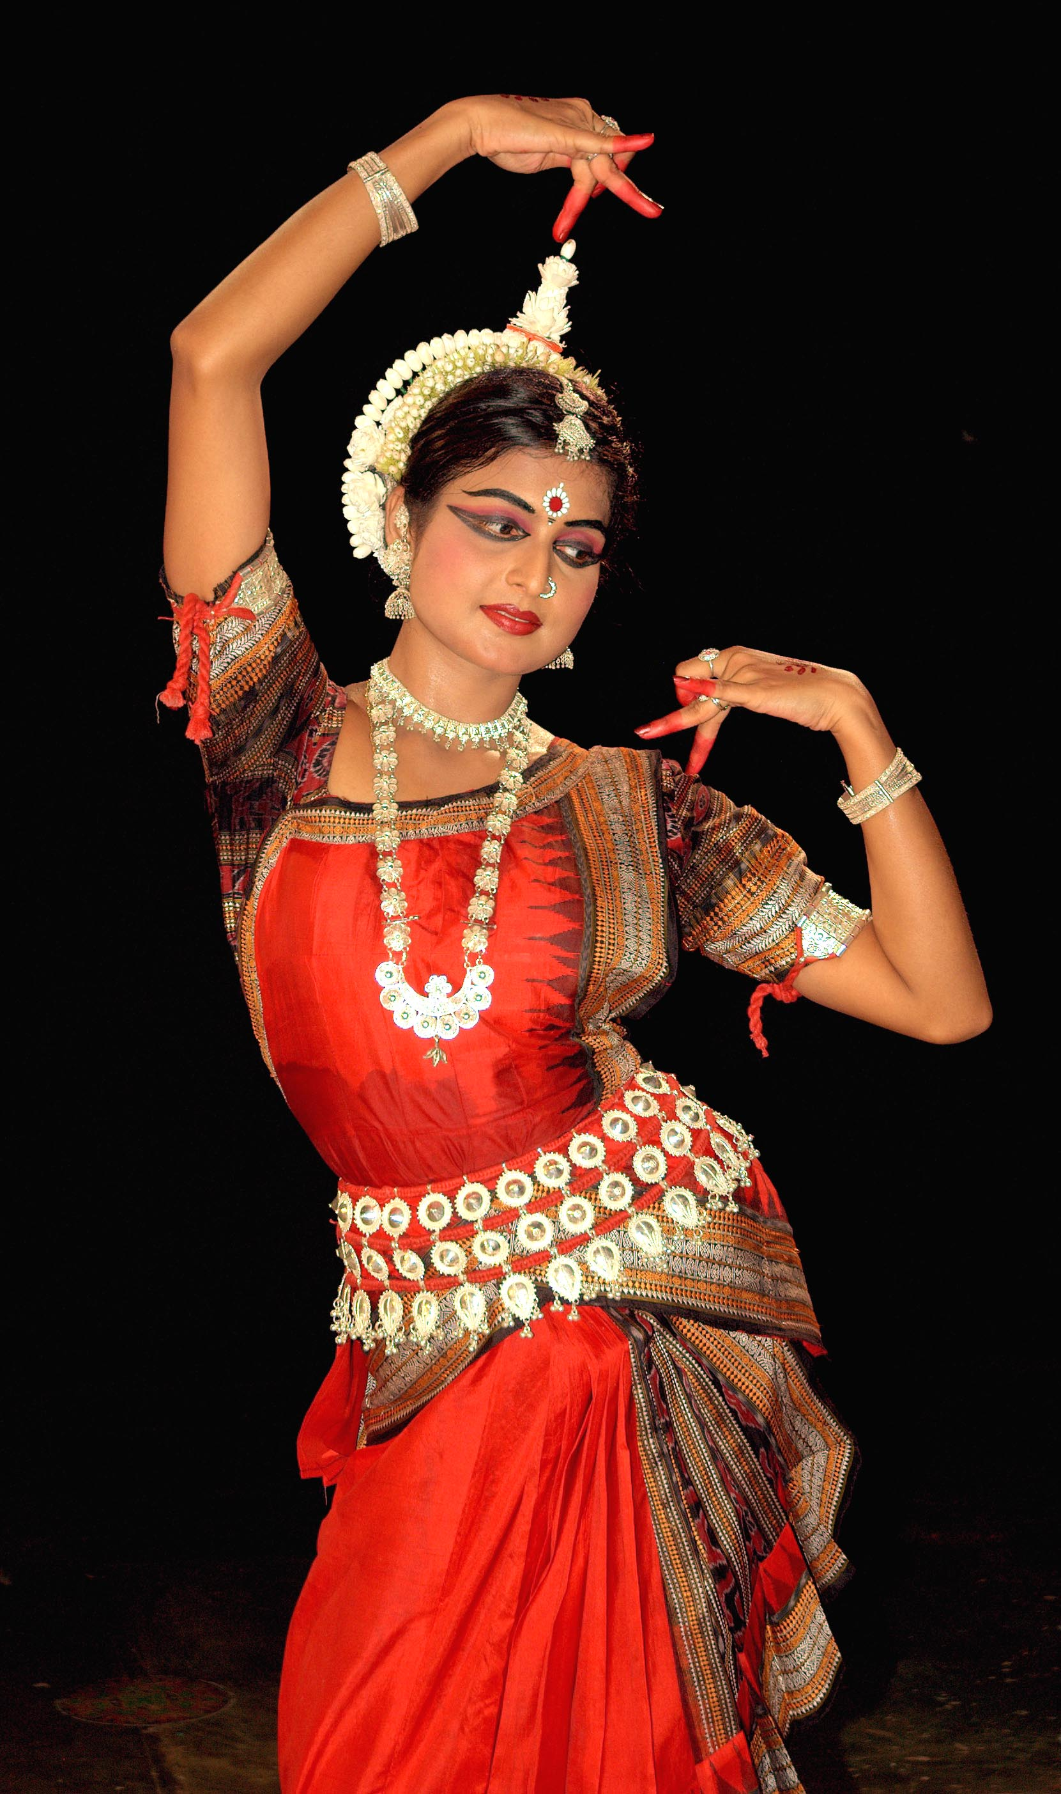
LINGA PADAKKA MUTHU MALAI - Necklace
In this Linga Padakka Muthu Malai (a garland of pearls with a Lingam pendant) from Tamil Nadu, rows of pearls end in a pendant in which the Lingam, the symbol of Shiva, is shaped out of an emerald and set in an elaborate encrusted base supported by two bejewelled peacocks with their rich plumes swinging upward. The lower pendant has the usual lotus motif. The other names for this are haar, Mala etc
It was believed in ancient India that flawless pearls prevented misfortune and were therefore favourites with kings.
Sometimes the pendant enclosed a scroll of sacred words worn as an amulet to ward off evil. Figures of the family deity were often engraved in gold and encrusted with stones in the pendant.

Slide 18
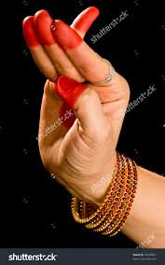
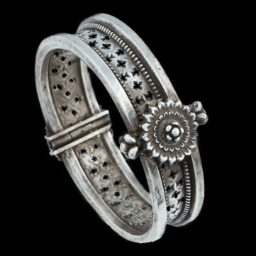
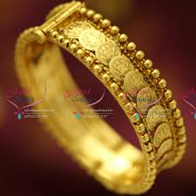
Kada – wrist ornament
Two sets of bangles worn on the wrist are called as Kadas or Kankanas
In this pair of Kadas worn by Kathak dancers from Varanasi (Banaras), the inner side of each Kada is covered with floral designs of pink enamel, a specialty of Varanasi which is quite rare. On the outer side are uncut diamonds with the ends of each Kada ornamented by elephants with intertwined trunks.
Kadas could be hollow, solid, or filled with lac. The ends of the Kada were of different designs such as of two parrots, twin elephants etc. Stone-set Kadas are often covered with enamel on one side, the method used usually being the champleve. The goldsmith carves out the design after which the enamel is painted or brushed into the hollows. It is then fixed in place by fire, a very difficult art.

Slide 19
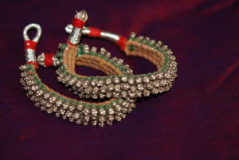
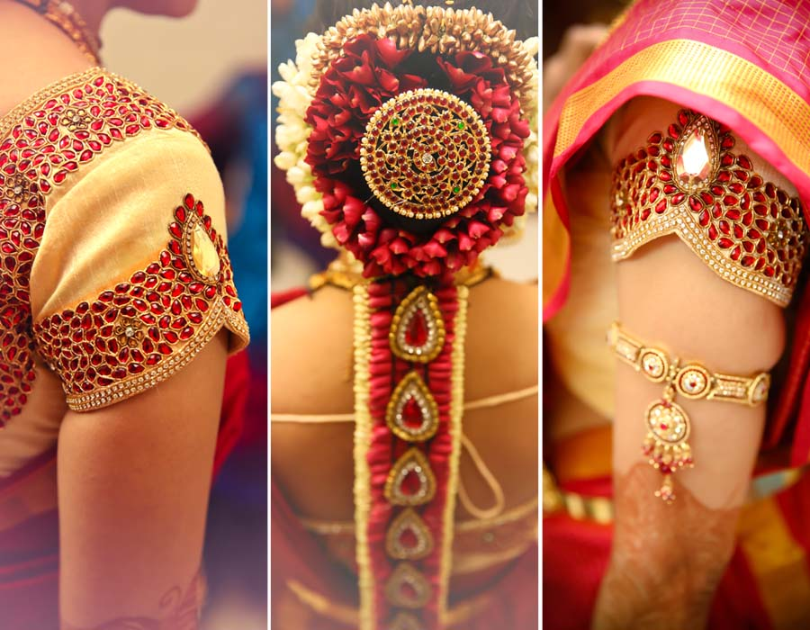
Vanki - Arm Ornament
The Vanki, or armlet, is inlaid with rose-cut diamonds, cabochon rubies and emeralds. An effect of coiled snakes is seen in the gold work on either side in the lower part of the Vanki. Two parrots lead up to the top of the Vanki from which drops a typical lotus-motif pendant.
There are different types of armlets, bajuband worn by Kathak dancers, Bahichudi by Odissi dancers etc. However the Vanki of Bhartanatyam is unique because of its inverted-V-shaped design.
From old paintings and sculptures, it appears that its origin can be traced to snake worship.
The shape of the Vanki is such that if fits over the arm without any strain or pressure.

Slide 20
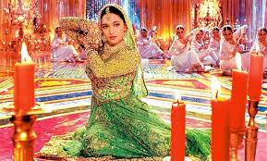
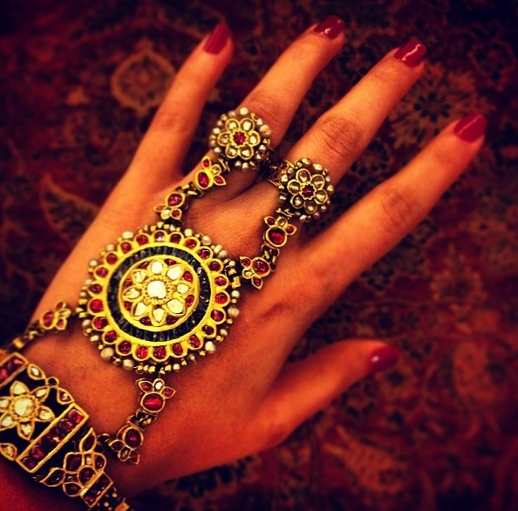
HATHPHOOL
This Hathpool (or flowers for the hand), also called the Panchangala (or jewel for the five fingers), is from Rajasthan.
It consists of a Kundan-set flower-encrusted bracelet with stone-set chains leading to another flower on the back of the palm and similar chains connecting it to the five rings on the five fingers, each ring with a different flower motif.
It is worn on the hands with a flower like focal resting in the centre with a ring (or rings)in the finger(s) and a bracelet or bangle on the wrist.
They were very popular in the Mughal era and were believed to be a staple jewellery of the Kathak dancers at that time too.

Slide 21
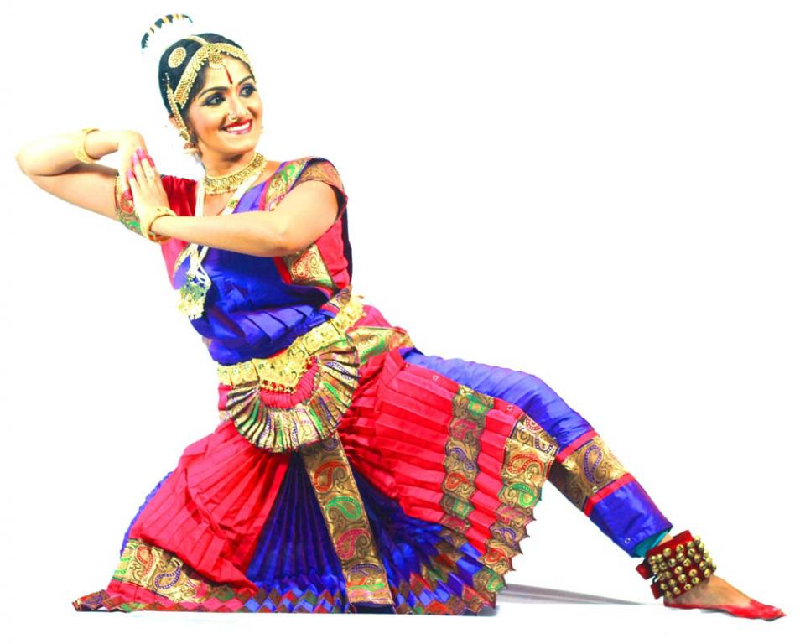
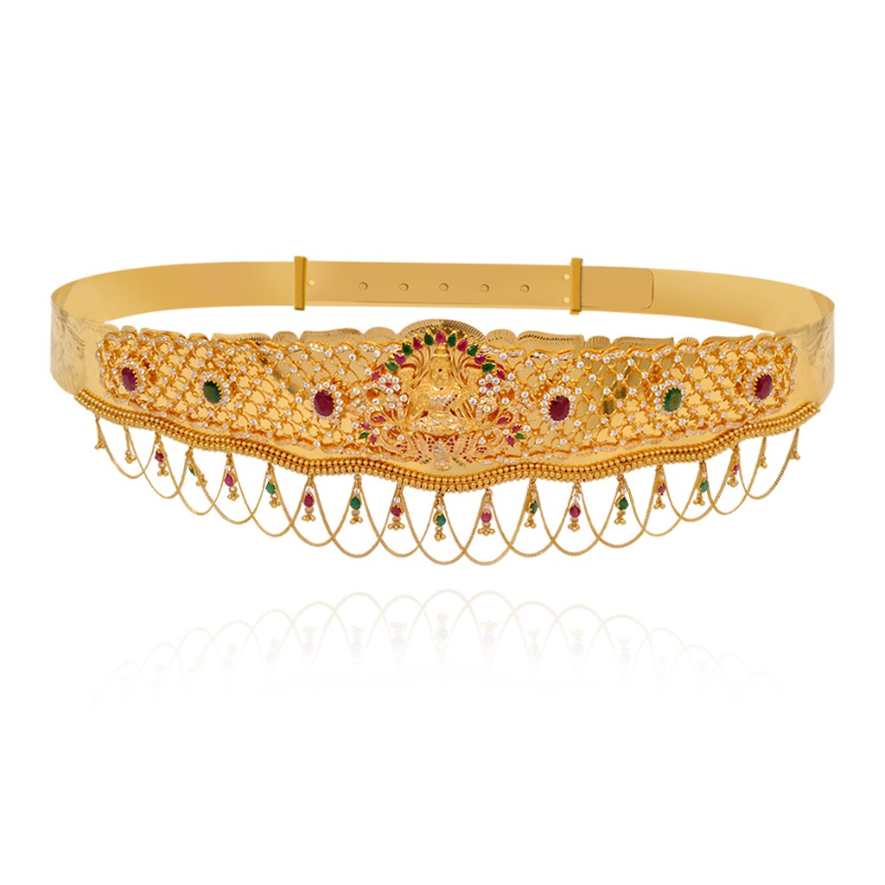
ODDIYANAM – WAIST ORNAMENT
This gold Oddiyanam or waist ornament of South India is encrusted with rose-cut diamonds, emeralds and rubies. Peacocks, flowers, buds and leaves intermingle in riotous profusion, but in perfect symmetry.
Although the purpose of the Oddiyanam is to hold up the saree. It served the additional purpose of keeping the waist slim, as the breath was drawn in before the belt-clasp was fastened.
The tight belt around the waist further accentuated the hips of the wearer and drew a subtle attention to the hips.

Slide 22
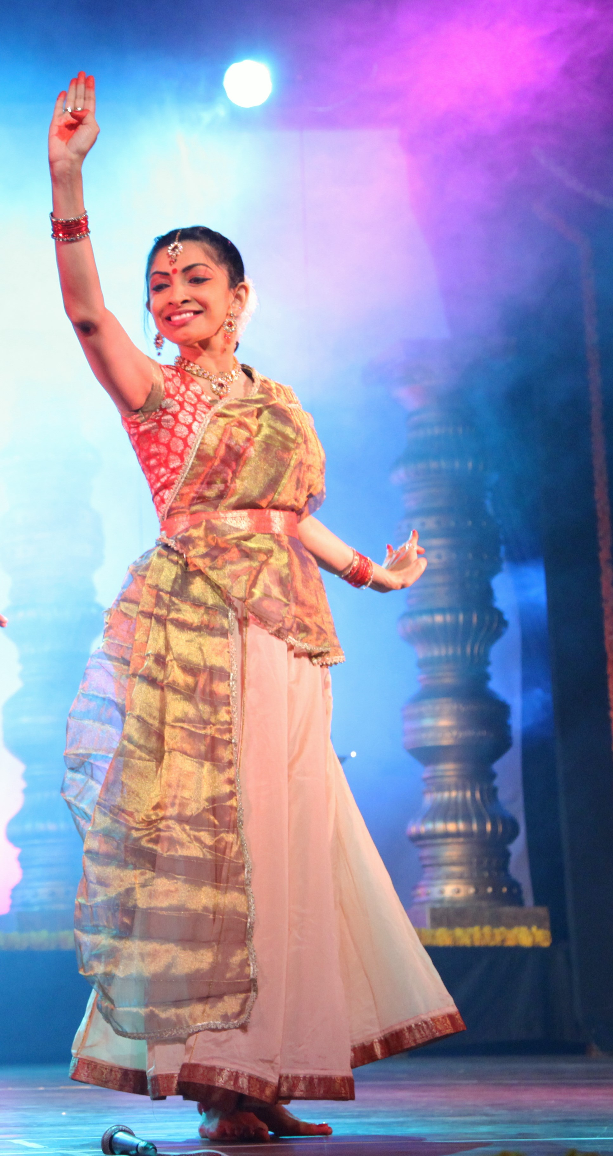
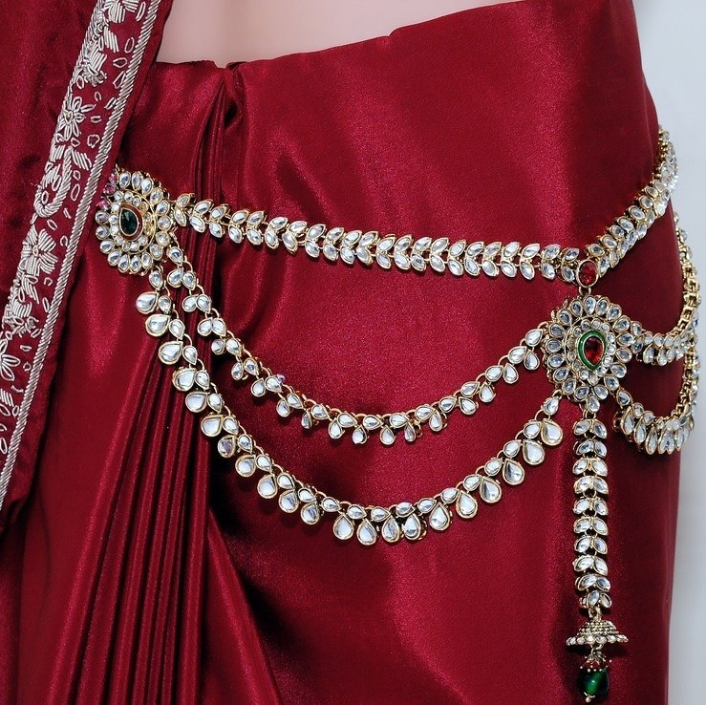
KAMAR BAND – CHANDRAHAAR
Kamarband” or “The Saree Belt” is worn around the waist resting delicately at the waistline. It could also be made from cloth itself.
This delicate piece of jewellery can accentuate the appearance of a dancer when worn around his/her waist.
Chandrahaar is another waist ornament from Bengal, (meaning a garland of moons), comprises of a series of chains made up of minute gold balls held in criss-cross gold wire, leading down to an elaborate filigree pendant with a floral motif. The clasps on either side are, again, smaller filigreed flowers.
Sculptors have carved elaborate versions of this jewel on figures in the temples of Orissa. Worn by in all Indian Classical dance forms.

Slide 23
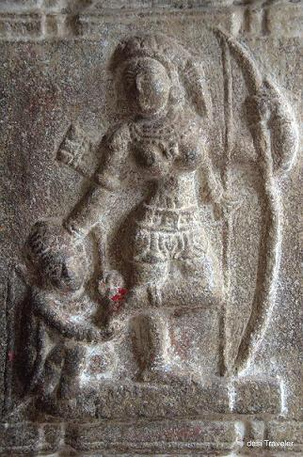
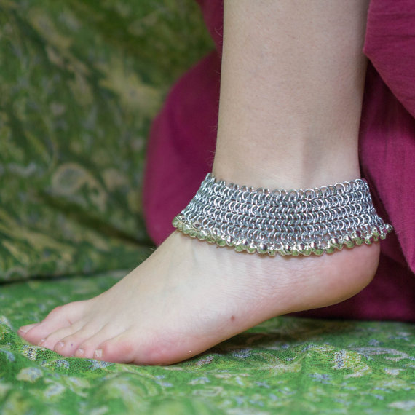
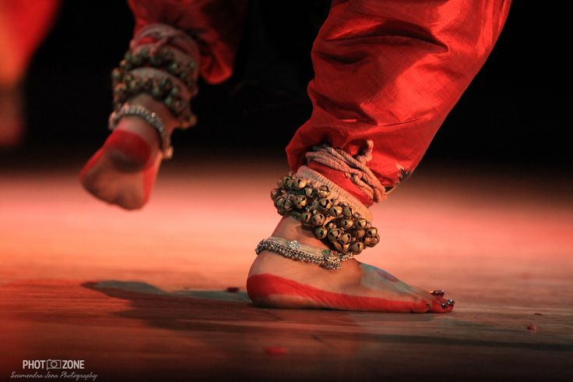
PAYAL – PAUNJI – PAIZEB
FOOT ORNAMENT
An anklet, also called ankle chain, ankle bracelet or ankle string, is an ornament worn around the ankle. in India, it is commonly known as payal.
There are two kinds of Anklets: Flexible and Inflexible.
The former are made by tying links in a chain, attached by hooks to toe rings. Sometimes, minute bells are attached on the outer edges of the anklets that make a tinkling sound when a person walks.
The latter, are created from shaping flat sheets of metal and do not require as much skills as is required in the flexible ones.
The Paizeb is from Hyderabad. Loose chain links between the uncut diamonds set in gold in Kundan settings, make the anklet lie flat on the foot fitting closely over the ankle. There are stone drops on the lower edge of the Paizeb in place of tinkling bells.
Dancers usually wear silver anklets.

Slide 24
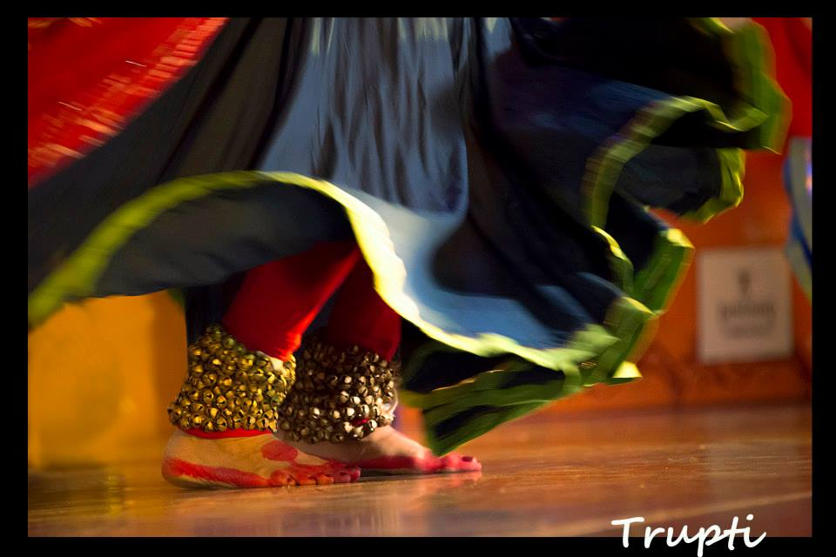
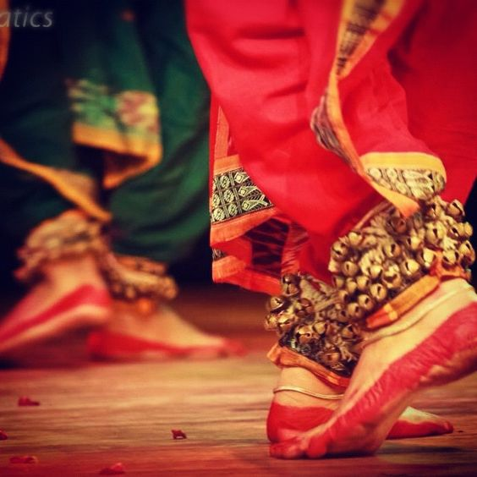
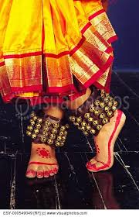
GHUNGROO
A Ghungroo, Salangai(Tamil) is one of many small metallic bells strung together to form Ghungroos, a musical anklet tied to the feet of classical Indian dancers. apart from their aesthetic value the basic motive of the anklet is to draw attention to the wearers legs and feet.
The sounds produced by Ghungroos vary greatly in pitch depending on their metallic composition and size.
Ghungroos serve to accentuate the rhythmic aspects of the dance and allow complex footwork to be heard by the audience.
They are worn immediately above the ankle, resting on the lateral malleolus and medial malleolus. A string of ghungroos can range from 50 to greater than 200 bells knotted together. A novice child dancer may start with 50 and slowly add more
Ghungroos or Salangais are worn in traditional performances of the classical Indian dance forms: Bharatnatyam, Kathak, Kuchipudi etc.

Slide 25
Summary
Jewellery as an integral part of dance, from ancient times
Not just for beautification of the artist, but has a predominant part in the dance vocabulary.
Some dance jewellery has a functional purpose, generally to fix clothing or hair in place.
Each style has a distinct set…each item has a purpose and a role to fulfil.
The designs in solid gold jewellery of Tamil Nadu and Kerala are inspired by nature. the Meenakari and Kundan styles of jewellery making have been influenced by the Mughal dynasty
Bharatanatyam dancers wear a unique set of jewellery known as "Temple Jewellery" during the performance. Kathak dancers wear kundan jewellery. Odissi dancers wear jewellery made from intricate filigree silver jewellery pieces, so on and so forth.
Challenges for the artist to dance with this elaborate system on their body. It hurts, falls off, needs to be pinned properly etc
Some jewellery pieces act as a carrier or symbol of meaning – such as love, mourning, represent a character or even luck. Like the peacock feather or Mukut which is an essential Odissi dance jewellery is to used to denote love for Krishna etc..
As an artistic display to retain the uniqueness of the dance form.
Some common ornaments not covered include from different dance forms, finger rings, toe rings , bangles. It’s a vast topic.

